Slide 1
0000
00/00/0000
00/00/0000
1
1
V2.0 Date 5.15.23

Slide 2
This is an alternate front page.
Place a team photo or other information here.
0000
00/00/0000
00/00/0000
1
1
V2.0 Date 5.15.23

Slide 3
Changelog
Changelog: V2.0 Date 5.15.23 - Added new template pages for controller map & brain map - Updated field map to 2023-2024 “Over Under” Game - Added second title page template for additional customizability
You can delete this page from your Team’s notebook!
Christine G.
5/15/2023
01

Slide 4
Resources
engineering.vex.com
notebooking.vex.com
coding.vex.com
Judging Rubric for Notebooks
vex.com
roboticseducation.org
VRC 2023-2024 Game - Rules & Game Video
Send suggestions and comments about these Digital Notebooks and Digital Parts
to notebooks@vex.com

Slide 5
12345 Title Title Title Date Date Date

Slide 6
##

Slide 7
##

Slide 8
Month
##

Slide 9
##

Slide 10
##

Slide 11
##

Slide 12
##

Slide 13
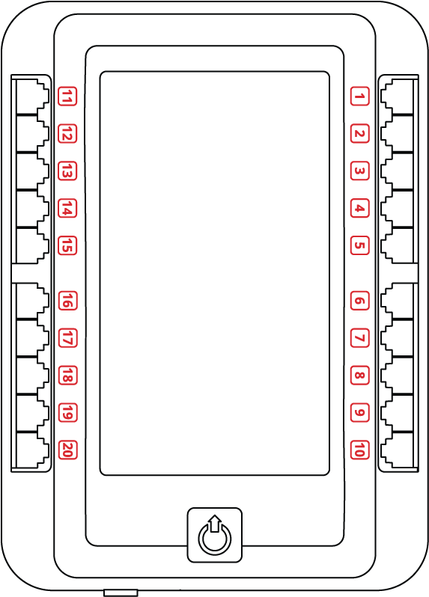
PORT
PORT
PORT
PORT
PORT
PORT
PORT
PORT
PORT
PORT
PORT
PORT
PORT
PORT
PORT
PORT
PORT
PORT
PORT
PORT
PORT
PORT
PORT
PORT
PORT
PORT
PORT
PORT
PORT

Slide 14
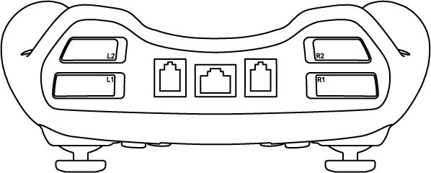
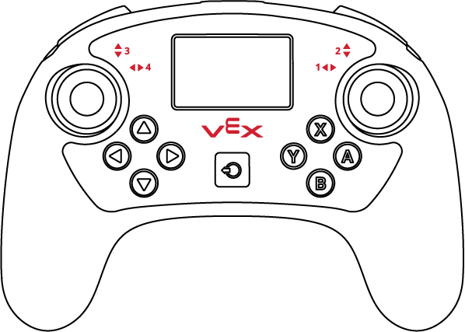
BUMPER
BUMPER
BUMPER
BUMPER
STICK
STICK
STICK
STICK
BUTTON
BUTTON
BUTTON
BUTTON
BUTTON
BUTTON
BUTTON
BUTTON

Slide 15
##

Slide 16
##

Slide 17
The game objects on this page are moveable
These tri-balls are underneath the bar. They are placed on top on this slide so they be can moved.
##

